Slide 1
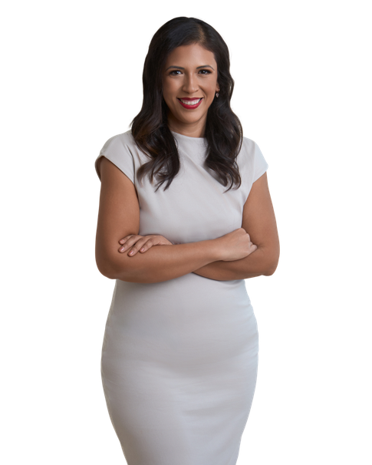

We are officially under contract!!
Congratulations!
123 Placeholder Ave.
Seattle, Washington
PURCHASE PRICE
EARNEST MONEY
$10,000,000
TBD
Here's the Timeline
Contacts
EFFECTIVE DATE
TBD
TITLE COMPANY
Lender’s Title Company
EARNEST MONEY DUE
TBD
203 Westport Drive #A
Cabot AR 72023
INSPECTION DATE
PENDING
Allison Wells/Rose Betcher
Phone: 501-843-2128
INSPECTION PERIOD ENDS
TBD
Email@company.com
APPRAISAL DATE
PENDING
LENDER
Lee Well
FINAL WALK-THROUGH
TBD
123 Street Address
City, State 12345
CLOSING DATE
TBD
Contact Name
Phone: 123-456-7890
Email@company.com
Notes
HOME INSPECTIONS
Inspection Company Name
Contact Name
We will wait to order appraisal until we get through the inspection period.
Phone: 123-456-7890
Email@company.com
We will need to send you a survey authorization to order the survey however we will wait on that also until we come to an agreement on repairs.
SURVEY COMPANY
Kevin Beadle
Title Company will order
Survey Authorization needed
Please let me know if you have any questions!
HOME INSURANCE
Pending
Contact Name
Phone: 123-456-7890
Email@company.com
325.829.2839
Diana.dominguez@icloud.com
www.pcsingtolittlerock.com

